Slide 1


Kotlin Basic Types
Characters

Slide 2
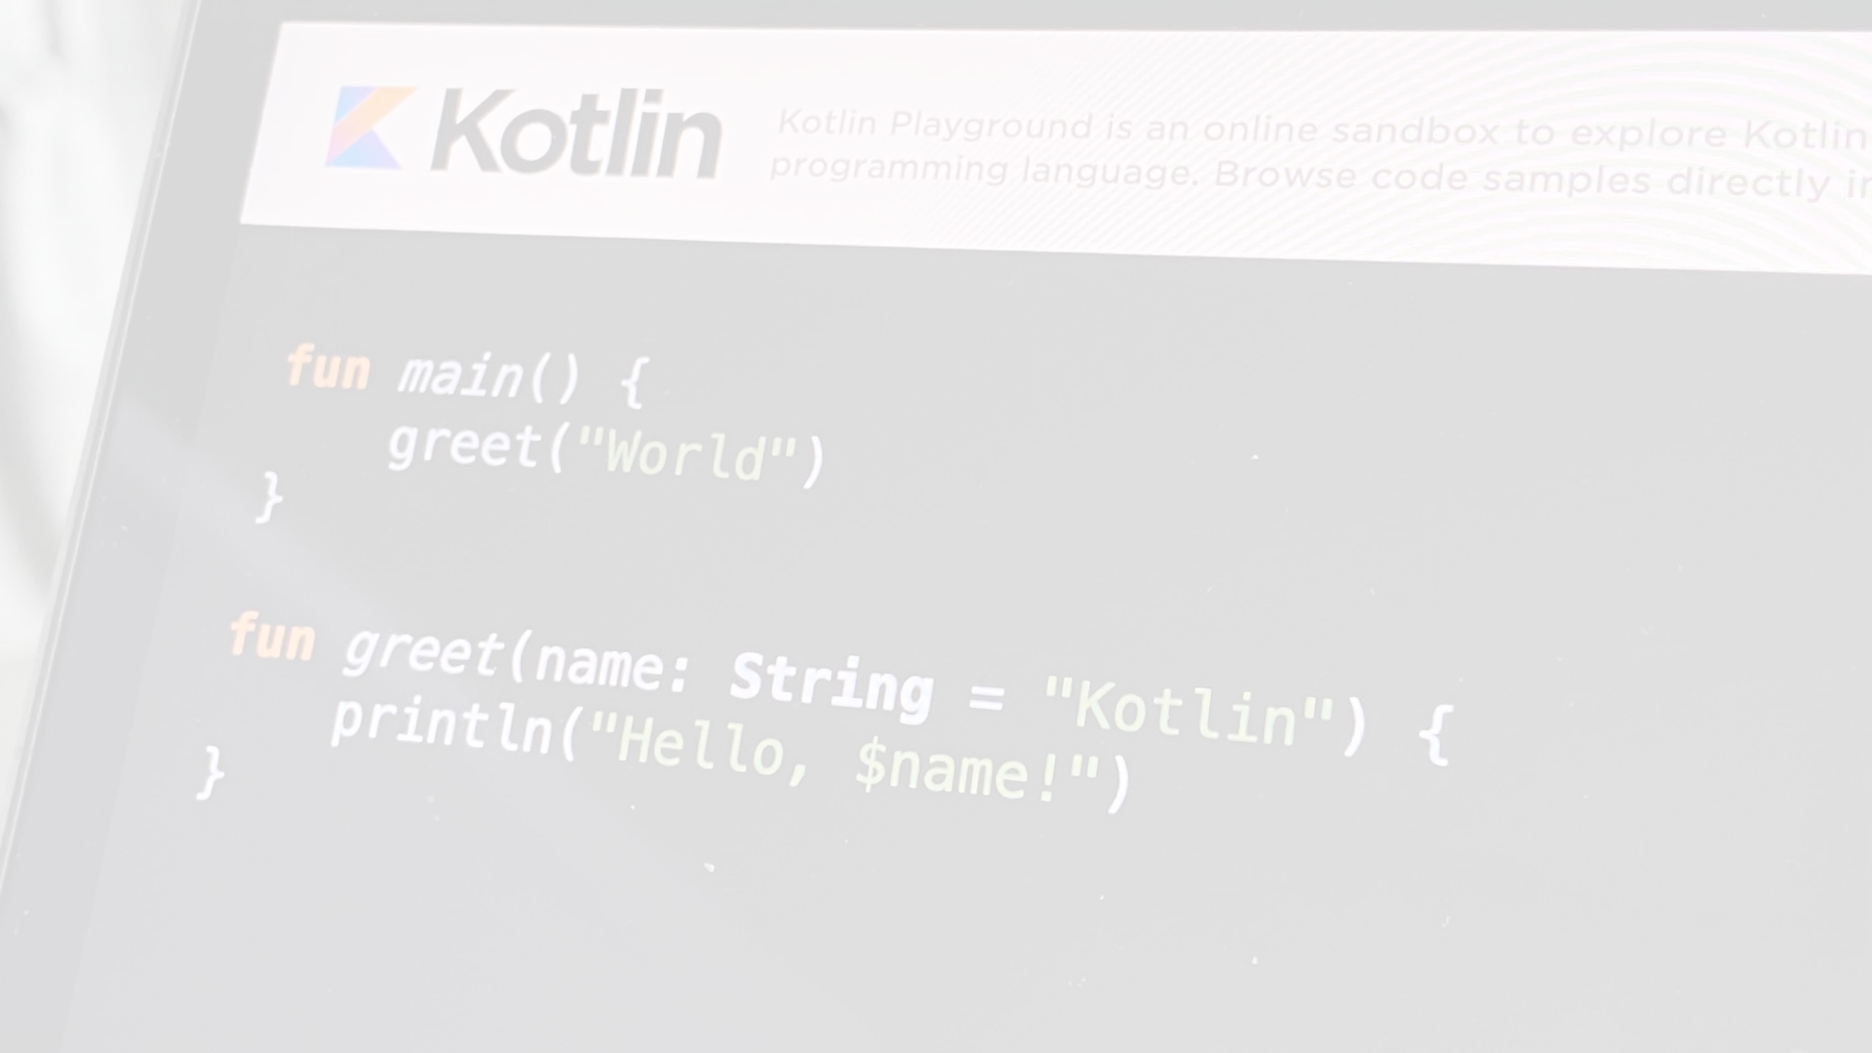
Characters are represented by the type Char. Character literals go in single quotes: '1'.
Special characters start from an escaping backslash \. The following escape sequences are supported:
\t – tab
\b – backspace
\n – new line (LF)
\r – carriage return (CR)
\' – single quotation mark
\" – double quotation mark
\\ – backslash
\$ – dollar sign
To encode any other character, use the Unicode escape sequence syntax: '\uFF00'.
val aChar: Char = 'a'
println(aChar)
println('\n') // Prints an extra newline character
println('\uFF00')

Slide 3
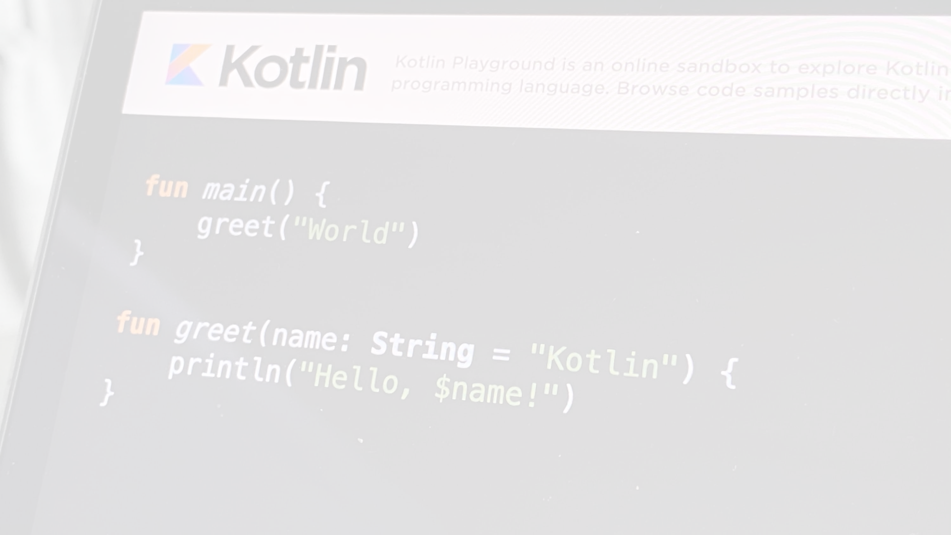
fun main() {
// Declare a Char variable
val firstLetter: Char = 'A'
// Print the value of the Char variable
println("First letter of the alphabet: $firstLetter")
// Using Char in strings
val myName = "John"
val lastInitial: Char = 'D'
println("My name is $myName and my last initial is $lastInitial")
// Char comparison
val char1: Char = 'a'
val char2: Char = 'A'
println("Are char1 and char2 equal? ${char1 == char2}")
// Char operations
val nextChar = firstLetter + 1
println("The next letter in the alphabet: $nextChar")
}

Slide 4
In Kotlin, you can represent characters using character literals. Character literals are written inside single quotes ('). Additionally, you can use escape sequences for special characters.
fun main() {
// Character literal
val specialChar: Char = '%'
println("Special character: $specialChar")
// Escape sequences
val newline: Char = '\n'
val tab: Char = '\t'
println("This is a $newline new line and a $tab tab.")
}

Slide 5
Kotlin provides some useful functions for working with Char values:
fun main() {
val digitChar: Char = '5'
// Check if the character is a digit
println("Is $digitChar a digit? ${digitChar.isDigit()}")
// Convert Char to Int
val digitValue: Int = digitChar.toString().toInt()
println("Digit value as Int: $digitValue")
// Uppercase and lowercase conversion
val upperChar: Char = 'b'
val lowerChar: Char = upperChar.toUpperCase()
println("Uppercase of $upperChar: $lowerChar")
}

